Slide 1
ARL ParaPower/PCM Tutorial
Caleb Anderson
08/12/2019

Slide 2
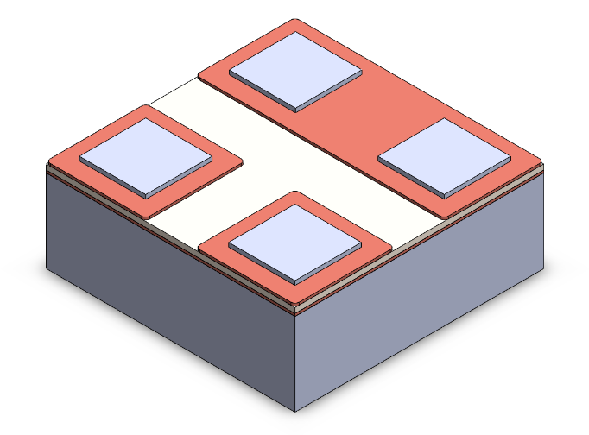
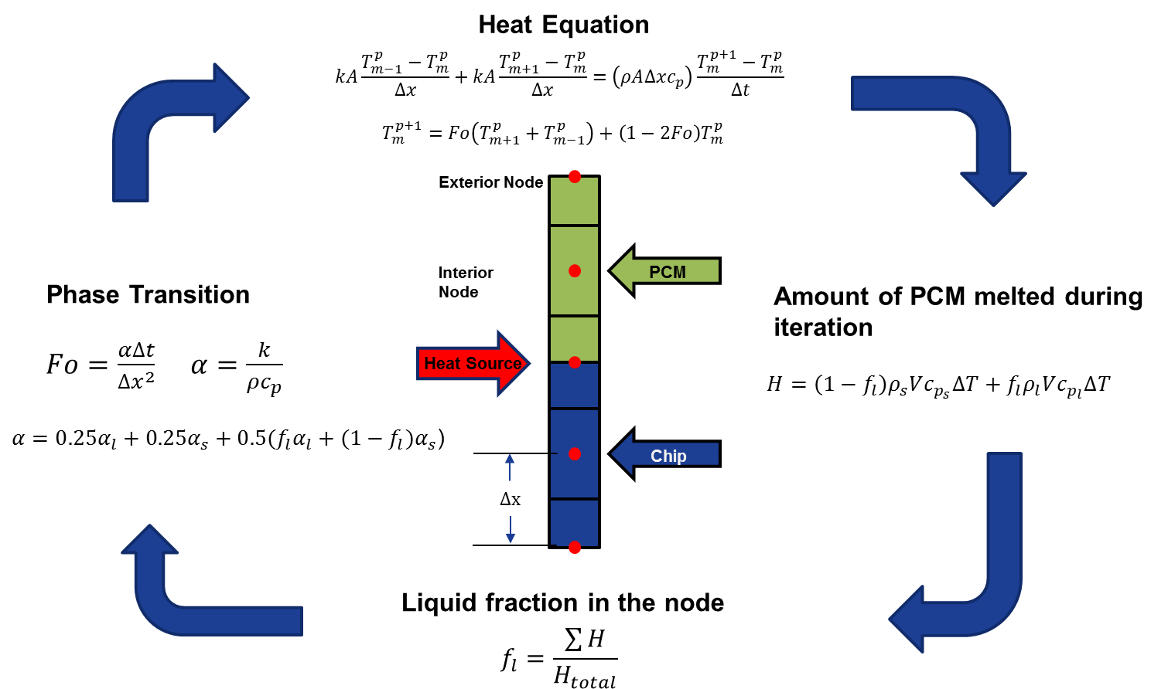
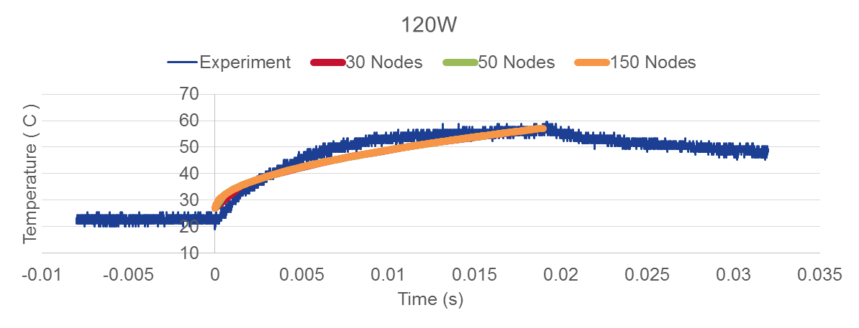
ParaPower Overview
3d Nodal Resistance Network
Transient thermal modeling capability
High fidelity PCM modeling tool
Multi-directional heat flow with finite difference method
Fast solver using matrix formulation
Can model any rectilinear (or cylindrical) 3D geometry using solids and PCMs
Reformulated in matrix form
Experimentally validated
Boteler, Lauren. (2018). IAPG Mechanical Working Group, ARL.

Slide 3
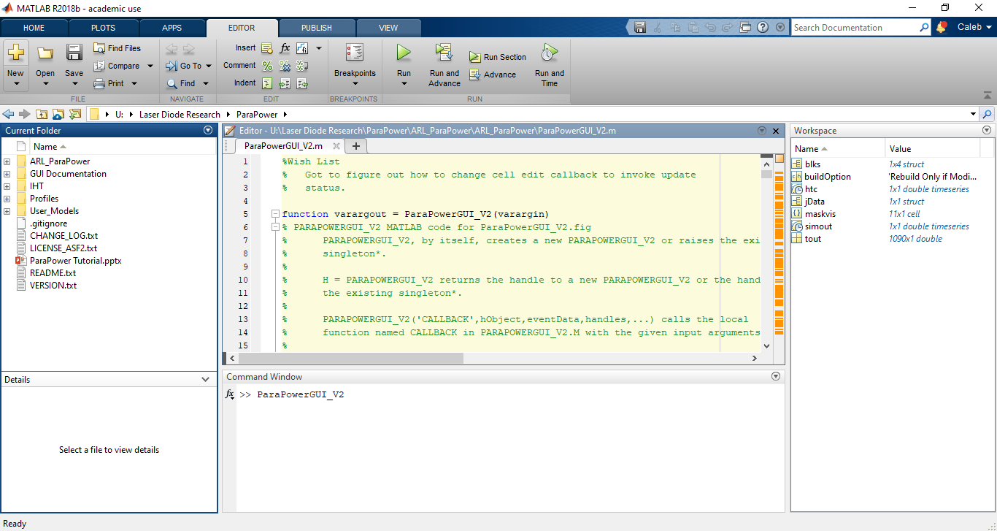
Starting ParaPower
Navigate to ParaPower in directory and add to path (folders and subfolders)
Type “ParaPowerGUI_V2” into command line

Slide 4
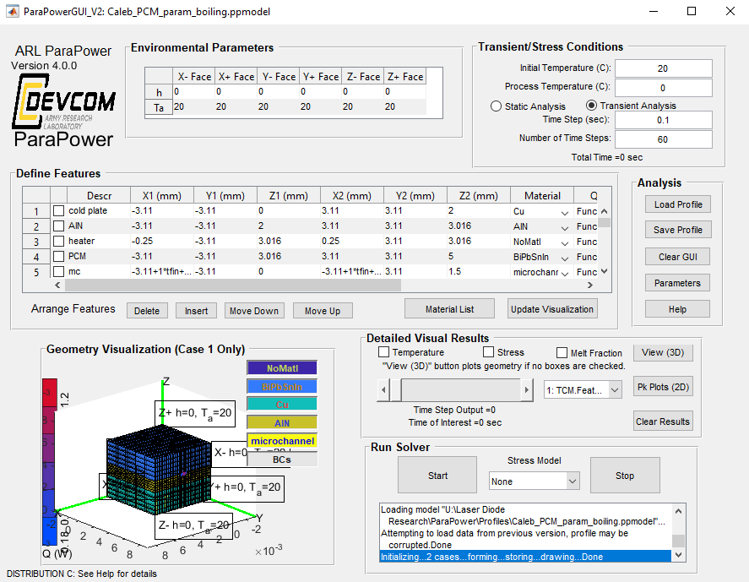
Graphical User Interface (GUI)
ParaPower can most simply be run via the GUI
The GUI includes several different sections for building and visualizing model information/results
ParaPower can perform transient or static temperature, thermal stress, and solid-liquid phase change analyses

Slide 5
Graphical User Interface (GUI)
Set external convective boundary conditions here
Set initial conditions, analysis type, and time information (if necessary)
Load/save, clear GUI, add/view parameters, help dialog
Define geometry, materials, and heat loads here
View detailed results by time step or parametric case and run/stop solver
Model visualization (click “View (3D) at right for larger interactive image)

Slide 6
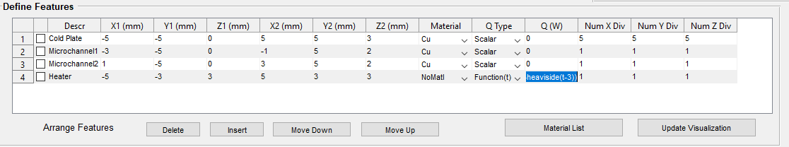
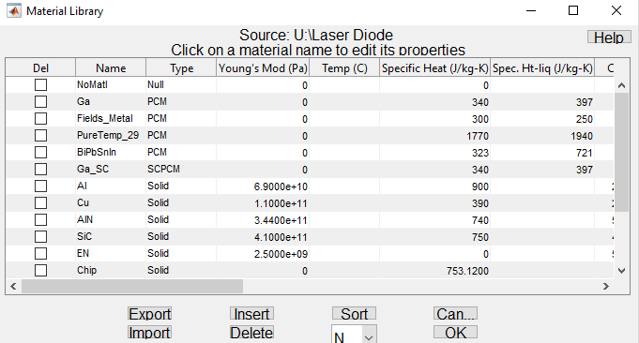
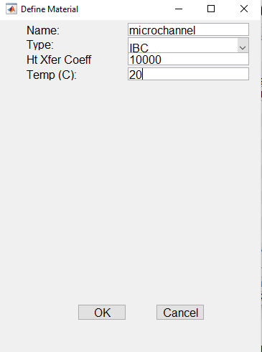
Add IBCs (internal boundary cavities) for Microchannels

Slide 7
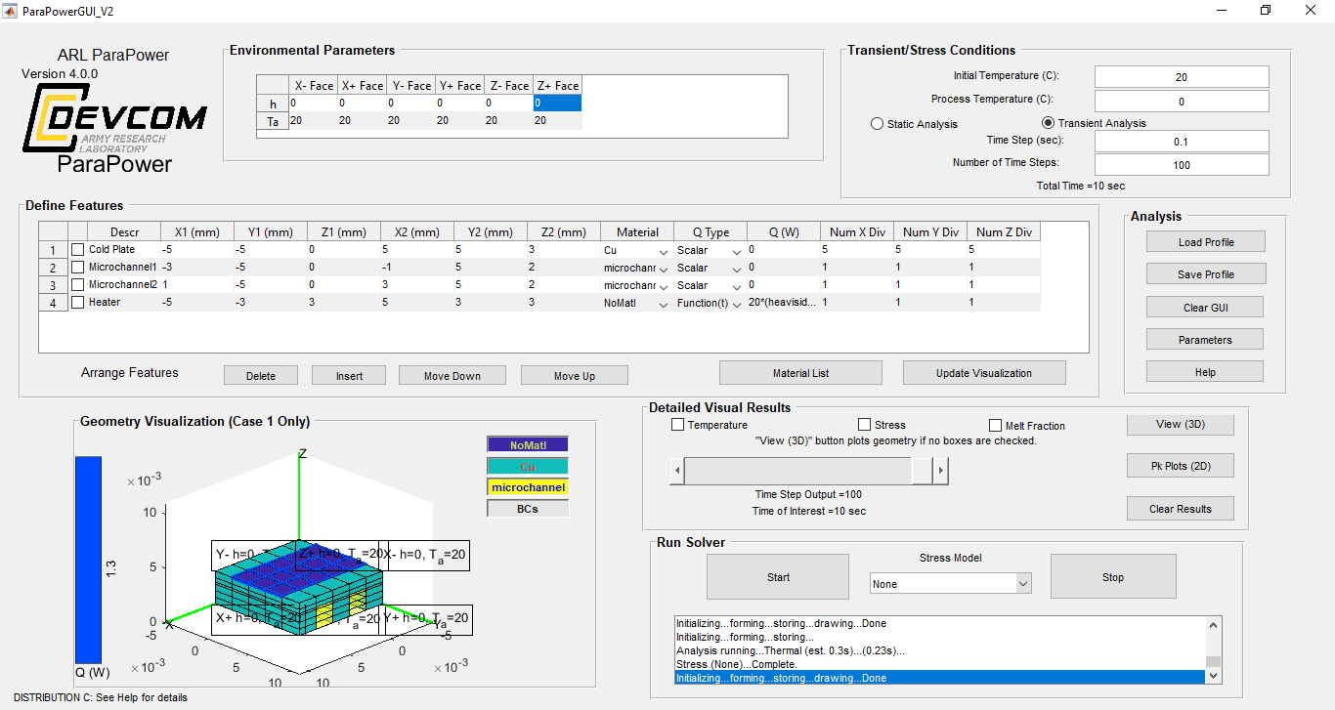
Building a Model
*Creates 2D heat source with infinite conductivity, Q(t) = 20*(heaviside(t+3)-heaviside(t-3)) (20 W, 3 sec heat pulse)
*Notice how extra divisions are drawn through heater, even though one division for each nx, ny, nz was selected

Slide 8
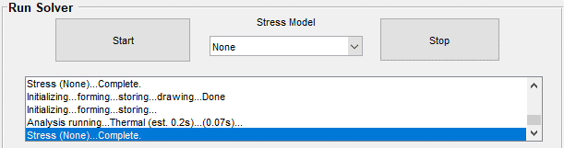
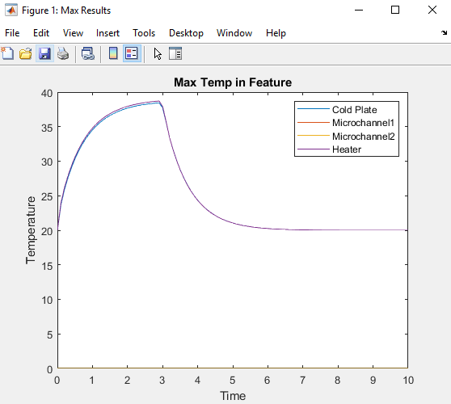
Solving the Model
When “Start” is clicked, the solver dialog outputs a time estimate for the analysis before completion.
The solver ran significantly quicker than the estimate in this case (~0.1 sec).
The resulting maximum temperature time series for the various model features is shown at right.
We see the 3 second heat pulse with the thermal mass of the cold plate affecting the rise and cooling time/temperature.

Slide 9
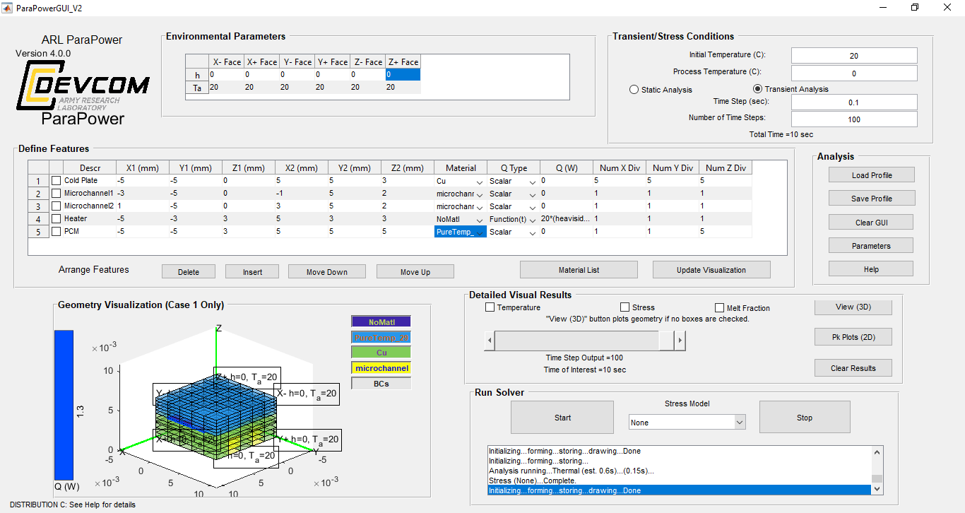
Adding a PCM

Slide 10
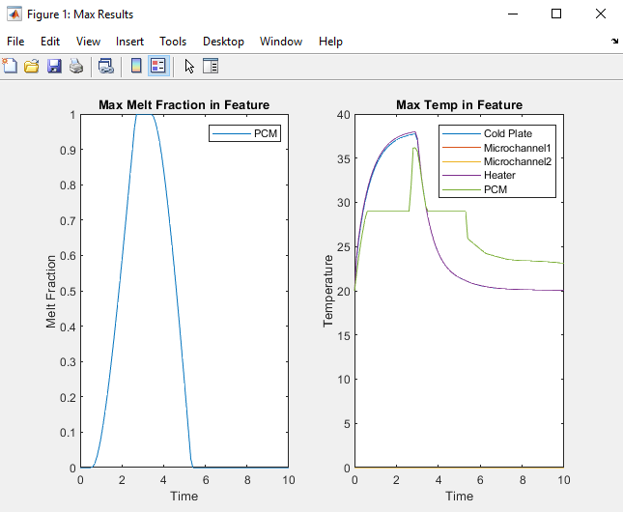
Effect of PCM
No PCM
With PCM
Notice that the addition of the PCM produces another plot tracking the maximum melt fraction of the PCM with time.
In this case, the PCM fully melted, and the max temperature series of the PCM shows the resulting isothermal phase change.
Finally, notice that the resulting temperature of the cold plate/heater is slightly lower due to the PCM absorbing some heat.

Slide 11
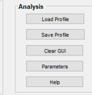
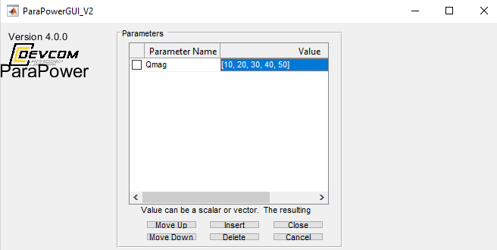
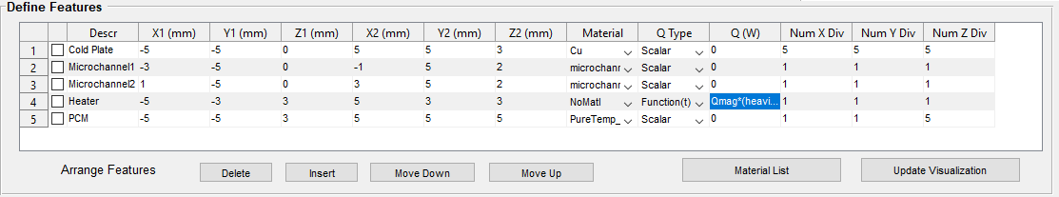
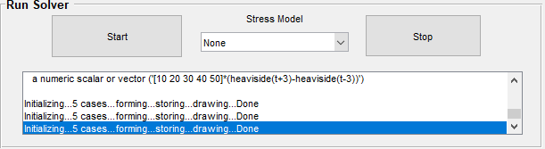
Adding Parameters
Can also insert vector of values directly into the “Define Features” boxes.
For example, in the “Q (W)”/ “Heater” entry, could enter “[10, 20, 30, 40, 50] *(heaviside(t+3)-heaviside(t-3))”
“Run Solver” dialog box indicates that 5 “cases” of the model have been created, indicative of the 5 parameter values.

Slide 12
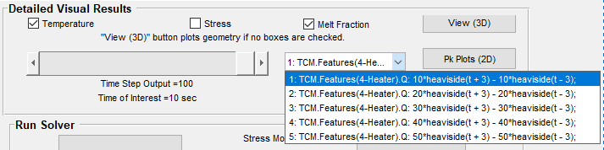
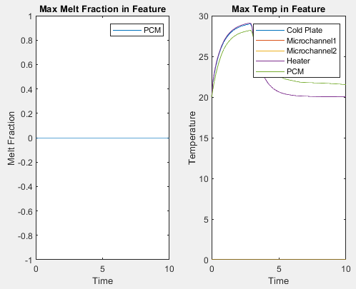
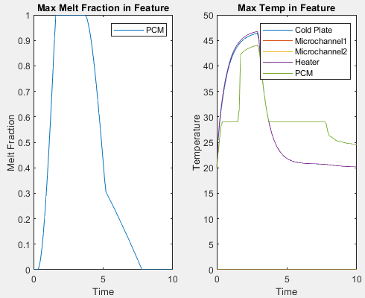
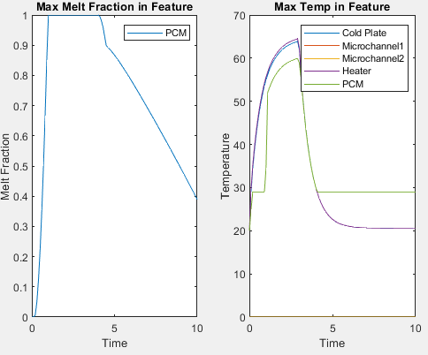
Visualizing Different Parameter Effects
*Run solver first
Can choose which case to examine.
Case 1
Case 3
Case 5
As expected, with higher heat loads, more PCM nodes melt completely and the PCM stays melted for longer. The maximum temperatures also expectedly increase.

Slide 13
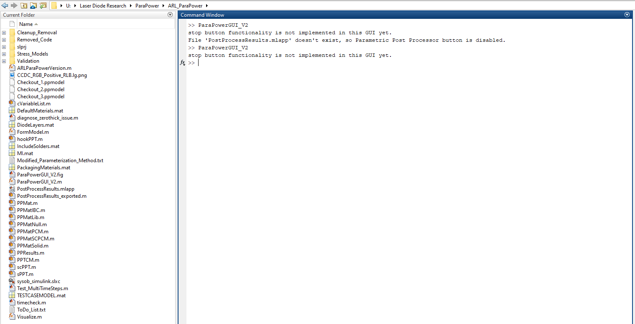
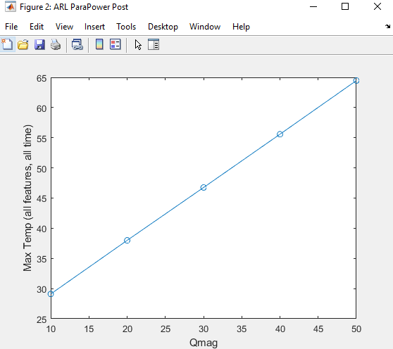
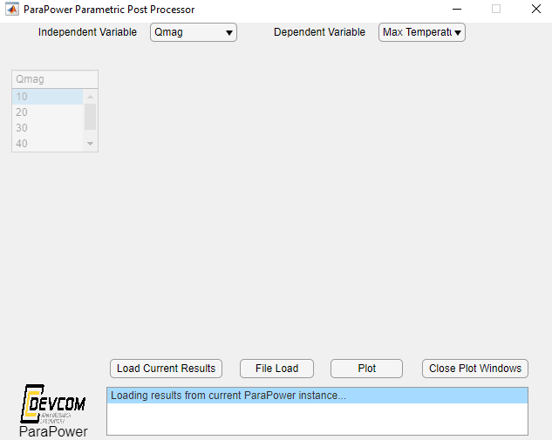
Visualizing Different Parameter Effects With the Post-Processing Tool
Right click and hit “run”
Max temperature increases linearly with heat load, as expected

